Slide 1

TECNOLOGIE E SOFTWARE PER IL DATA SCIENCE
Alket Cecaj, Postdoctoral Researcher, PhD
Artificial Intelligence Research and Innovation Center (AIRI)
Università di Modena e Reggio Emilia

Slide 2
Outline
● Introduction
● Data Science - a Seven Step-Pipeline
● Exploratory Data Analysis
● Recommendation Systems - Collaborative filtering
● Association Rules - Market Basket Analysis
● Unsupervised ML - Clustering
● Predictive Analytics - Linear Models
● Predictive Analytics - Classification Models
● Machine Learning Life-Cycle And Deployment
● Apache Spark

Slide 3
Intro to the Course

Slide 4

The data explosion and the ongoing revolution
● Mobile network data
● Industrial data
● Road traffic data
● Air traffic data
● Smart house data
● Health data
● Government data (open data)

Slide 5
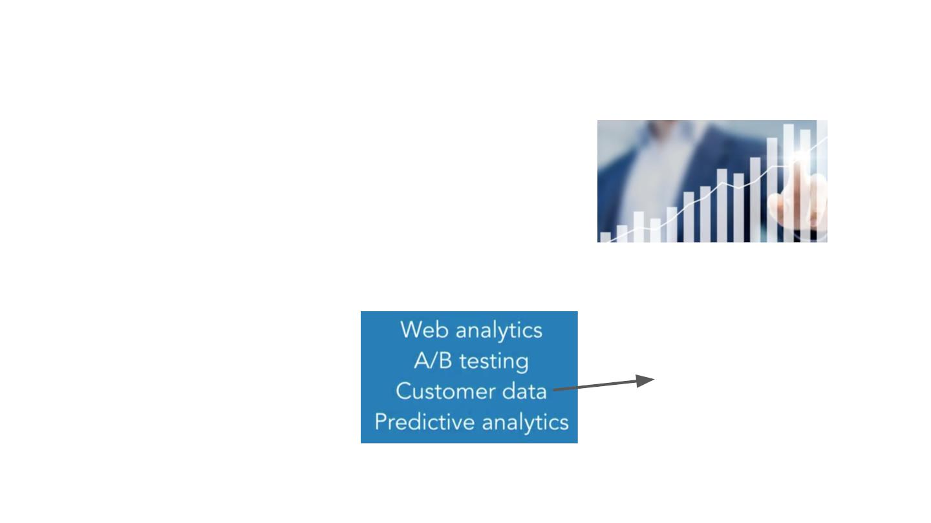
Why data science ? Economic value is the answer!
Companies can extract more value from
their business processes!
Impossible to list all use
cases but..
..here are some of the most
profitable ones.
Customer acquisition,
retention, sales
growth.. etc..

Slide 6

Open Data: a valuable resource for citizens
● Improving government → make the government
processes transparent.
● Empowering citizens
→
give citizens the tools to make
for improvement in areas like
informed and better decisions.
● Creating opportunity
air quality, security etc..
→
● Solving public problems → like pollution with innovative
ideas.

Slide 7
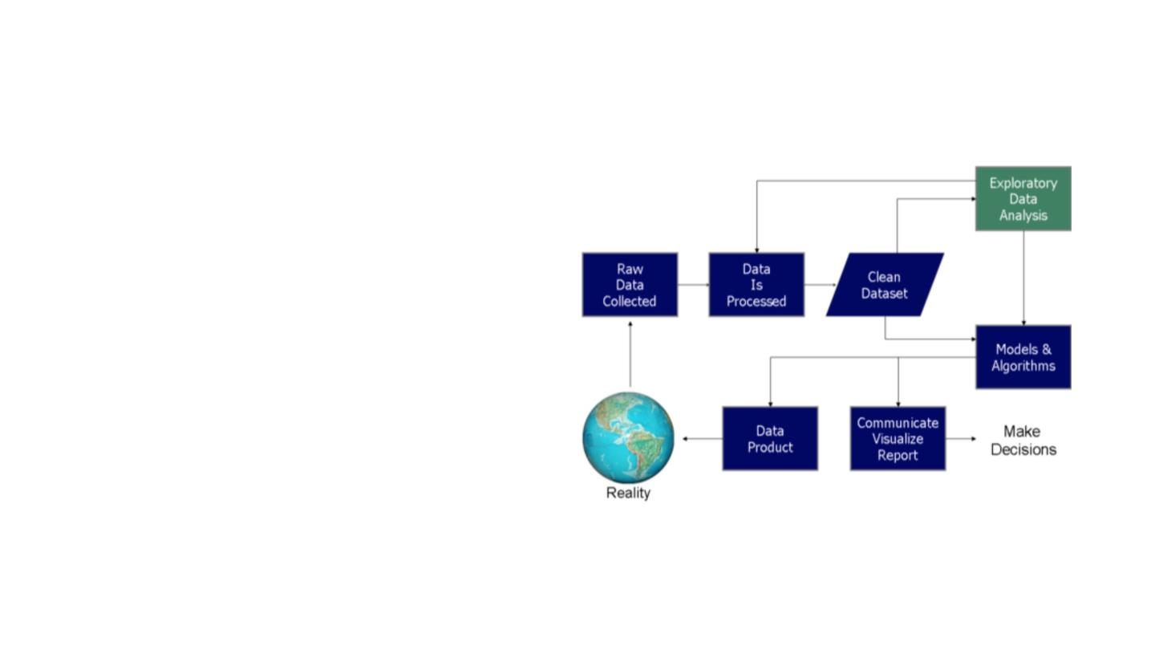
Knowledge Extraction Process
●
●
Knowledge from data: it usually starts with a
question that might be answerable with data.
Knowledge extraction is the creation of
knowledge from structured (CSV, JSON, XML)
and unstructured (text, videos, images) sources.
●
●
Knowledge extraction might be automatic (the
algorithms does everything) or semi-automatic
(the human has to intervene with decisions)
The resulting knowledge needs to be in a
machine-readable and machine-interpretable
format and must represent knowledge in a
manner that facilitates inferencing.

Slide 8
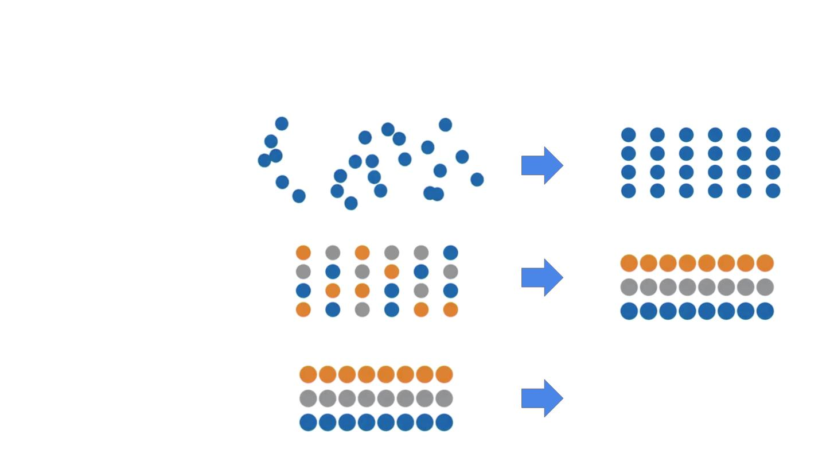
Sort, cluster and … what’s next?
Sort the data: is there
a pattern?
Find the different
groups
?
What’s next?

Slide 9
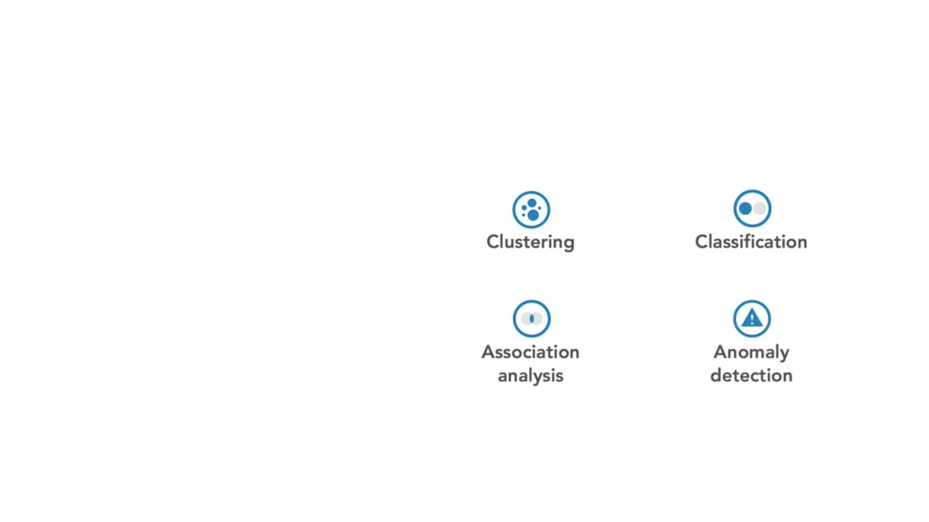
Some data mining tasks
Clustering : find similar items and
group them into clusters
Classification: when a new items
shows up, use the clustered data
to classify it.
Association rules: if a customer
buys beer will she/buy also chips?
Anomaly detection: business as
usual but then suddenly….

Slide 10
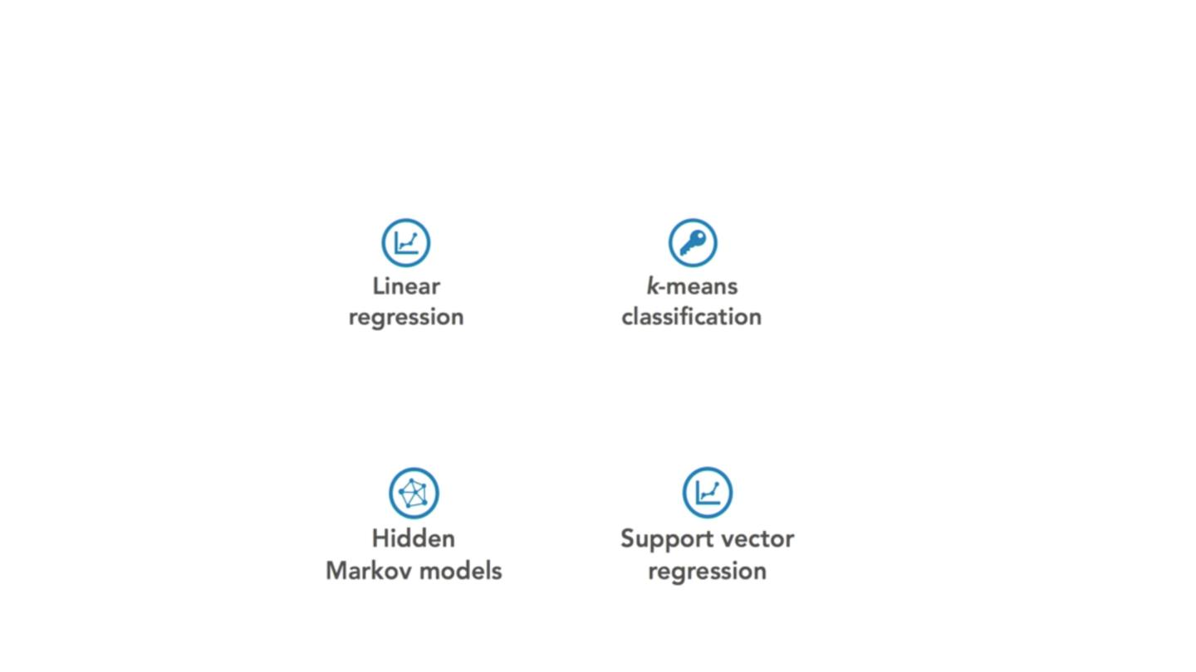
Data science methods
●
Statistical methods based on transparent statistics possible to calculate by hand.
●
Learning methods based on complex and opaque procedures that require substantial computing
power.

Slide 11
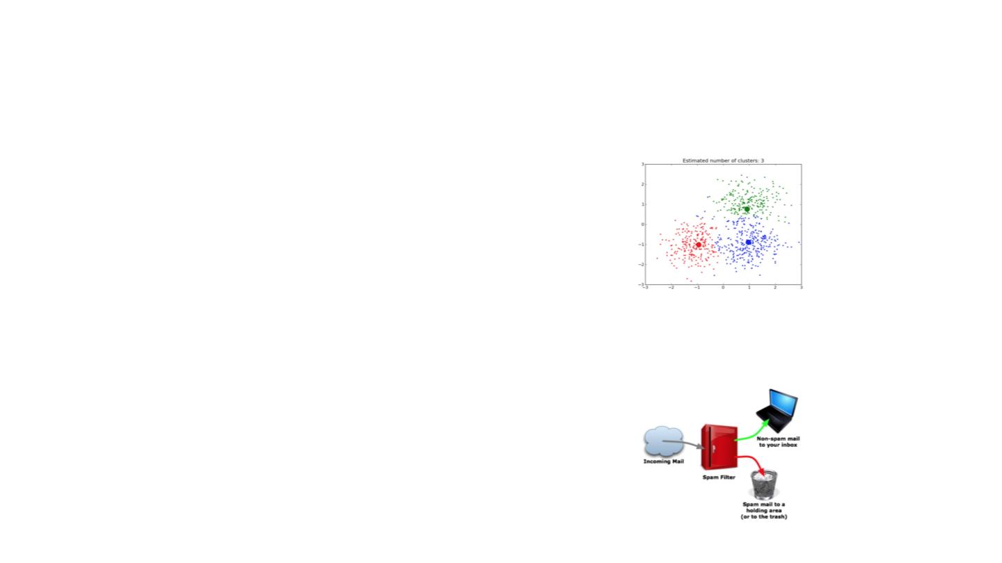
Machine Learning: Supervised and Unsupervised Learning
Unsupervised learning: is about finding possible groups and the hidden structure of the
data
●
●
●
Clustering algorithms: k-means, DBSCAN,
Anomaly detection: local outlier factor
PCA (Principal Component Analysis)
Supervised learning: leaning a function that maps and input to an output based on
examples
●
●
●
●
Regression : linear/logistic regression
Trees: decision trees, random forest
Naive Bayes: bayesian classifier
Neural Networks: Perceptrons

Slide 12
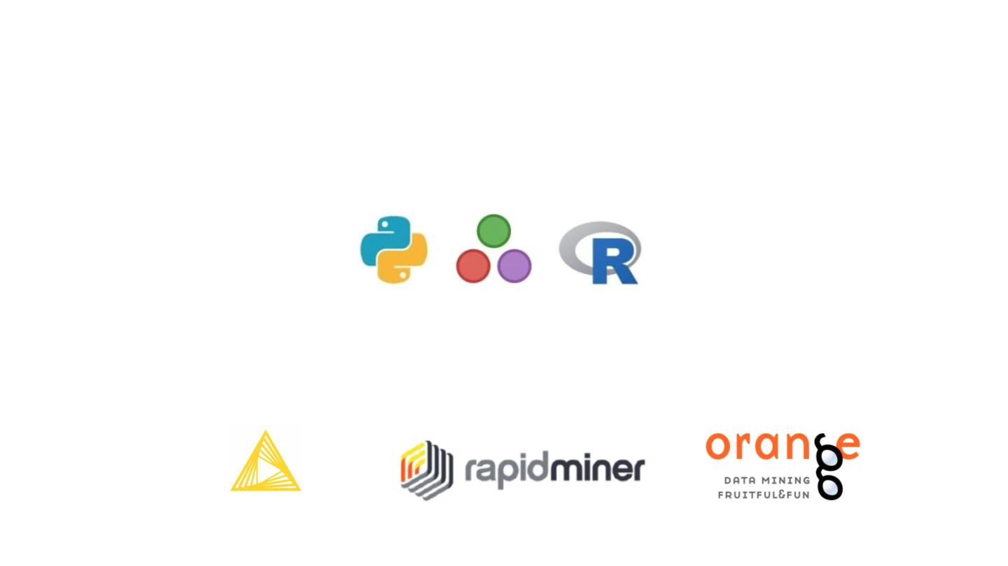
Tools and Software for data mining
● Programming languages: Python, Julia, R programming
● GUI Software for data mining : KNIME, RapidMiner, Orange

Slide 13
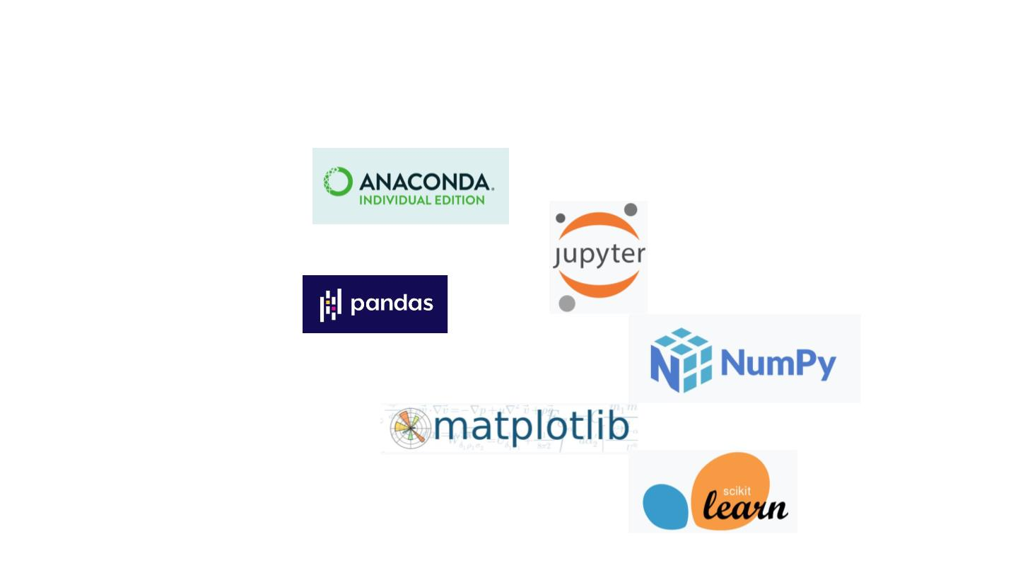
Python and the data mining/data science stack
● Anaconda
● Jupyter
● Pandas
● Numpy
● Matplotlib and …
● Scikit-learn

Slide 14
Install Python with Anaconda and related packages
● Anaconda : https://www.anaconda.com/
● Conda Virtual Environments :
https://docs.conda.io/projects/conda/en/latest/user-guide/tasks/man
age-environments.html#creating-an-environment-with-commands
● Pip package installer: https://pypi.org/project/pip/

Slide 15

Resources for Data Science and Machine Learning
Python Data Science Handbook:
https://jakevdp.github.io/PythonDataScienceHandbook/
Introduction to Machine Learning with Python:
https://millengustavo.github.io/intro-ml-python/

Slide 16
Hands-on Programming in Python: Ex1
Install Anaconda and explore all the options.
Fire-up Jupyter and take some time for: creating new cells, inserting
code and markdown, ecc..
Create a list/dictionary and iterate through the items/keys and values
Take decisions with if-else.

Slide 17
Data Science - a Seven Step-Pipeline

Slide 18

Knowledge Extraction Process Step-by-Step
Collect (some more) raw data
Clean and preprocess data
Exploratory Data Analysis (EDA)
Test models and algorithms
Build a data product
Communicate the results
Make decisions

Slide 19

Collect (some more) raw data - different sources.
1- Traffic and air pollution data from Emilia Romagna administrative region.
2- Economic and financial data from Yahoo Finance and Quandl
3- Web crawling / scraping for text and images
4- Railway traffic data
5- Data from the social networks like Twitter
6- Weather data
7- Google Datasets
8- Kaggle Challenges
9- What else?

Slide 20
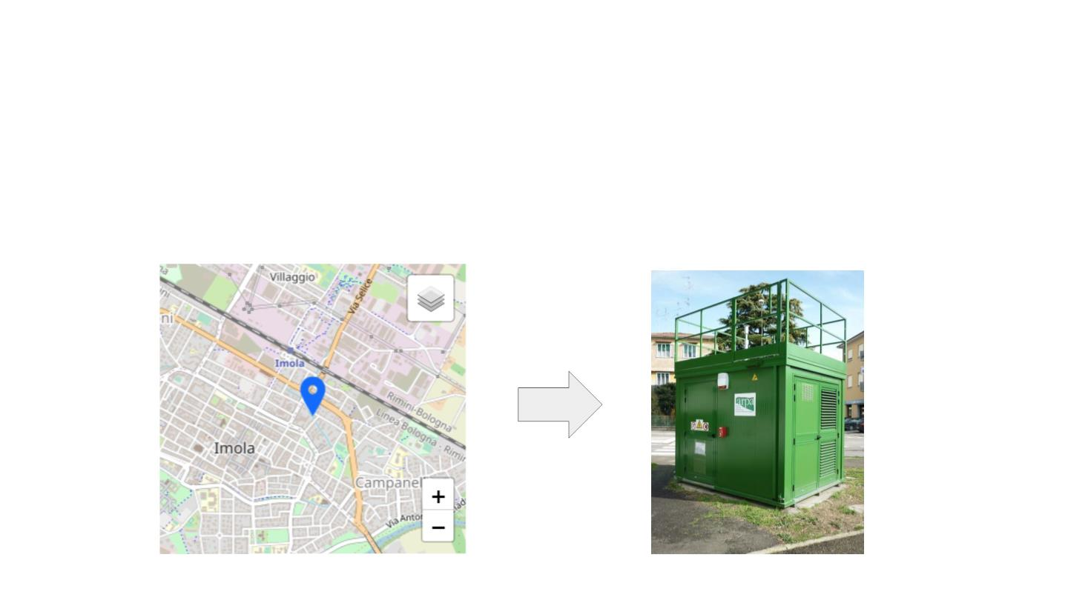
Collect real-world data from available sources - air pollution data
Air Pollution data from ARPA Open Data platform
https://www.arpae.it/dettaglio_generale.asp?id=2921&idlivello=1637

Slide 21
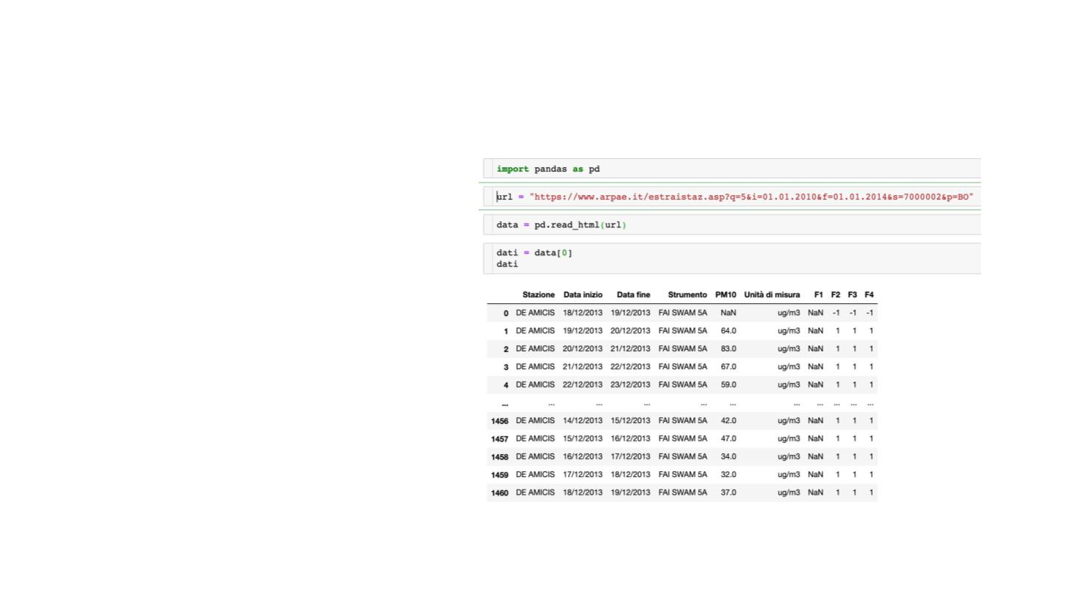
Collect NO2 and PM10 pollution data
●
NO2 is an air pollutants produced as a
result of road traffic and other fossil fuel
combustion processes. Its presence in
air contributes to the formation and
modification of other air pollutants,
such as particulate matter, and to acid
rain.
●
●
PM10, (suspended particulate matter)
which are coarse respirable particles
with a diameter of 10 micrometers (μm)
or less.
Air Pollution data from ARPA Open Data
platform
https://www.arpae.it/v2_rete_di_monitor
aggio.asp?p=BO&idlivello=1637

Slide 22
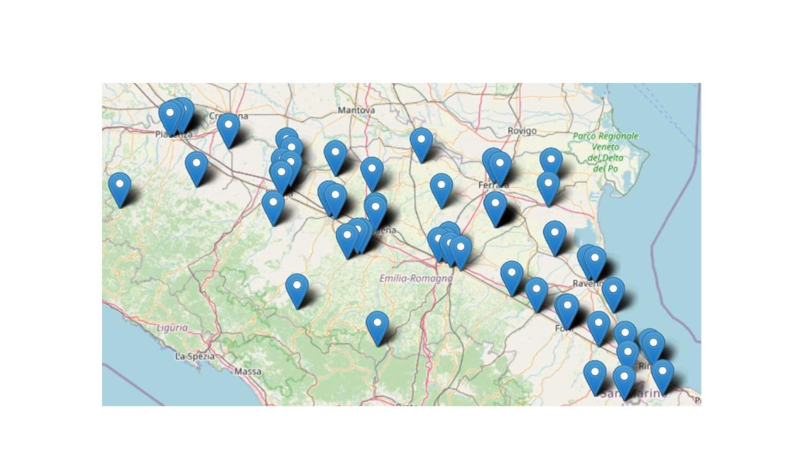
Location Data - Air Quality Monitoring Stations in Emilia Romagna

Slide 23
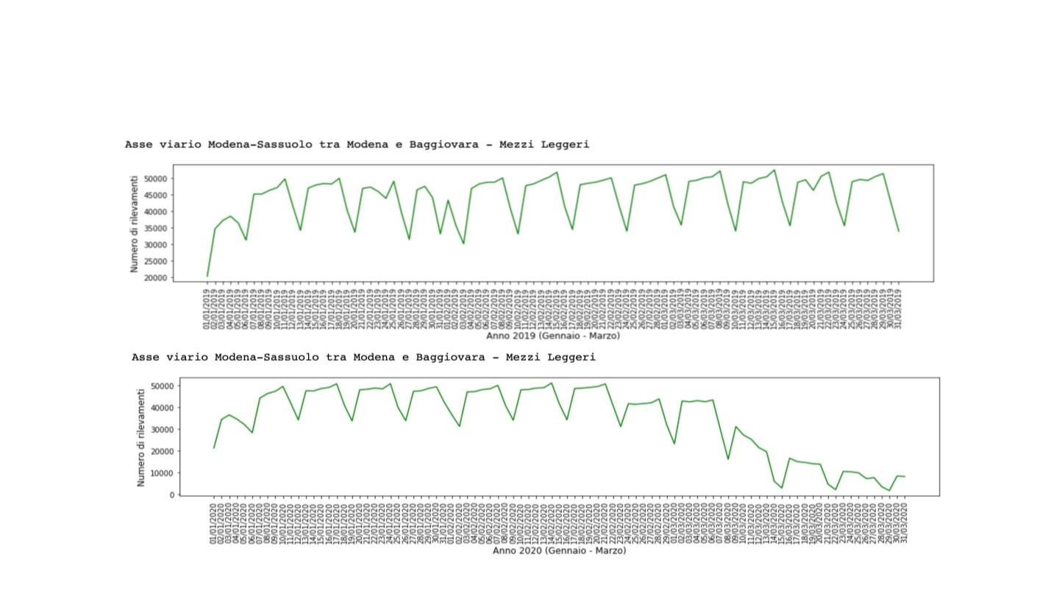
Traffic Data - MTS Emilia Romagna

Slide 24
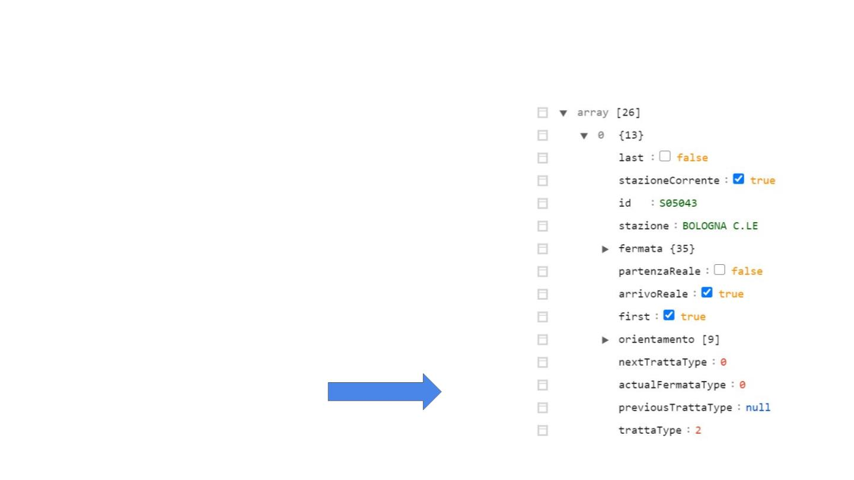
Data about Train Delays in Emilia Romagna
API ViaggiaTreno :
https://github.com/bluviolin/TrainMonitor/wiki/API-del-si
stema-Viaggiatreno
Check ViaggiaTreno :
http://www.viaggiatreno.it/viaggiatrenonew/index.jsp
Train Departures from Bologna Station:
www.viaggiatreno.it/viaggiatrenonew/resteasy/viaggiatreno/tratt
eCanvas/S05043/3846
API response in JSON

Slide 25
Exploratory Data Analysis

Slide 26
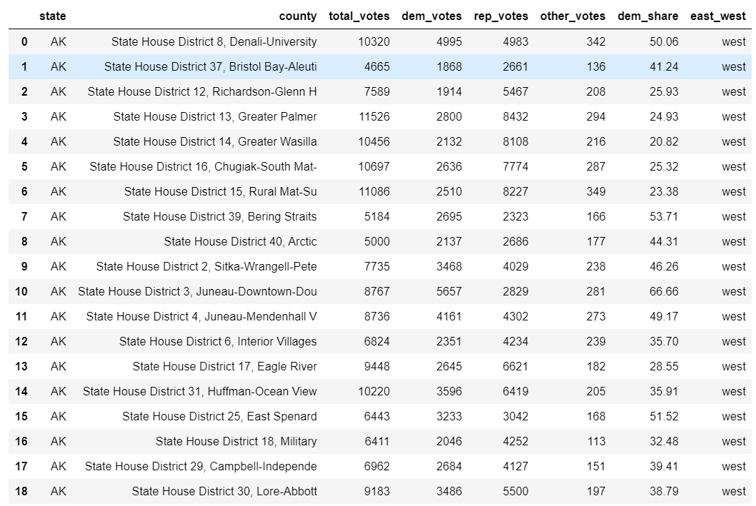
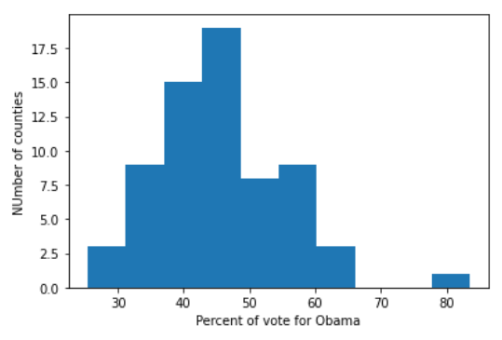

EDA - Exploratory Data Analysis

Slide 27
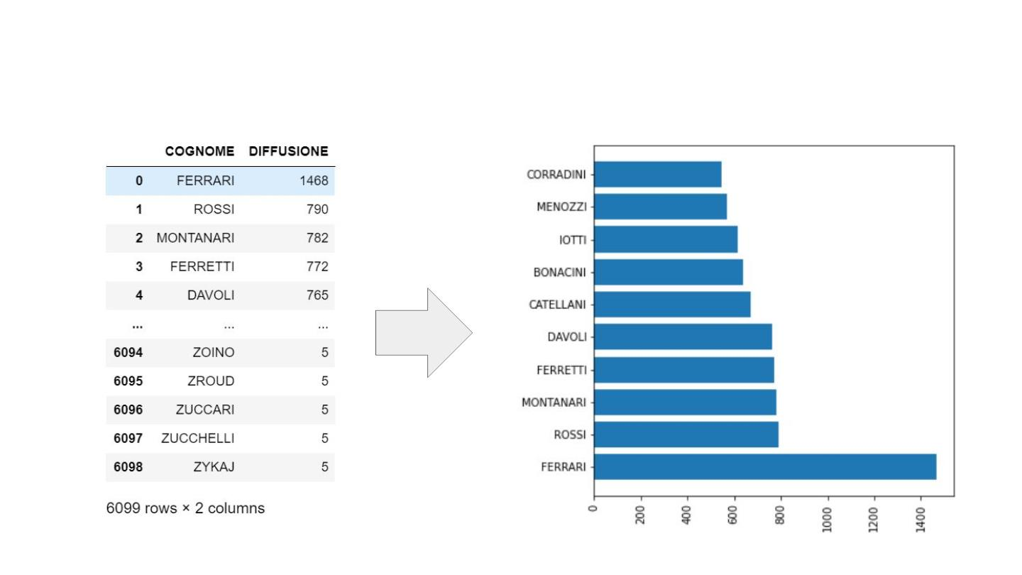
Demographics open data and civil registry - Reggio Emilia

Slide 28
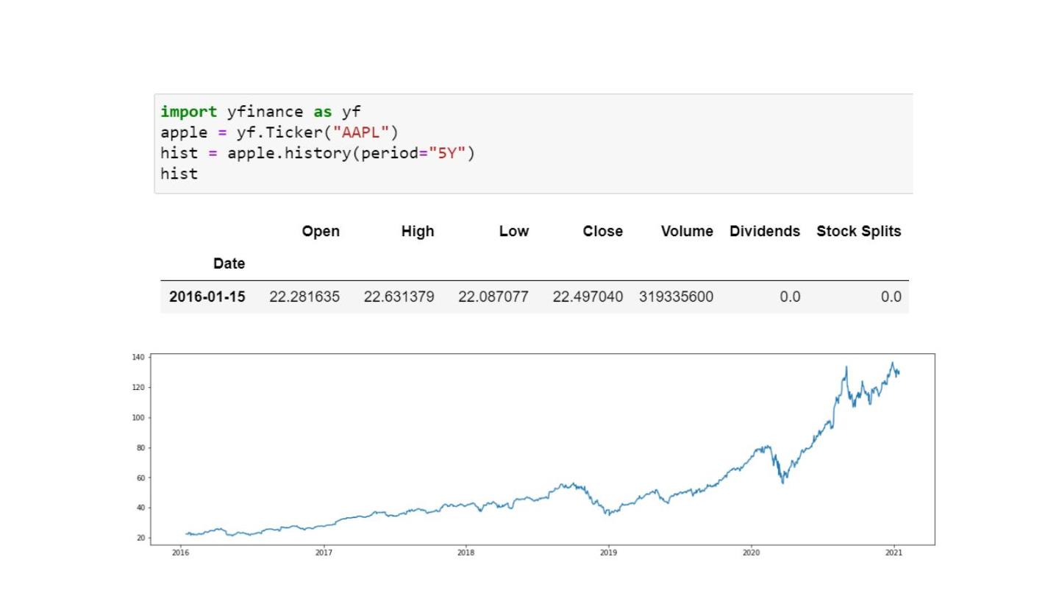
Financial data from Yahoo Finance and Quandl

Slide 29
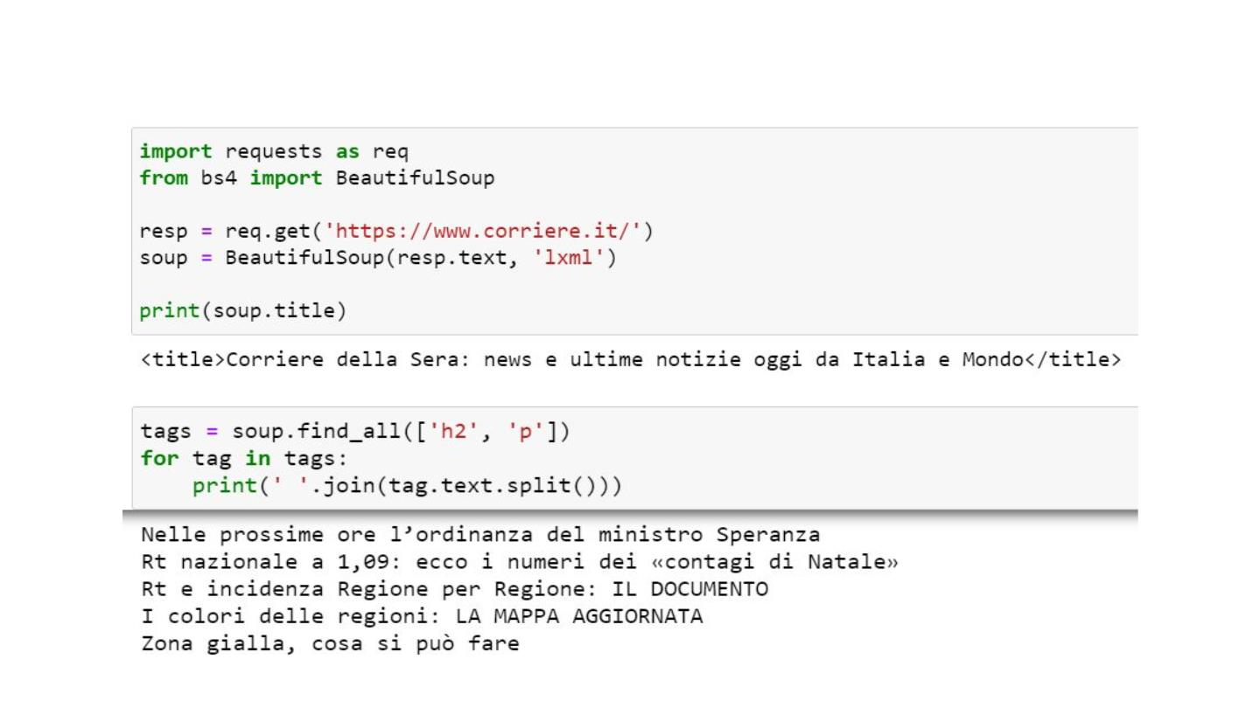
Web Scraping: Crawling for Text Data

Slide 30
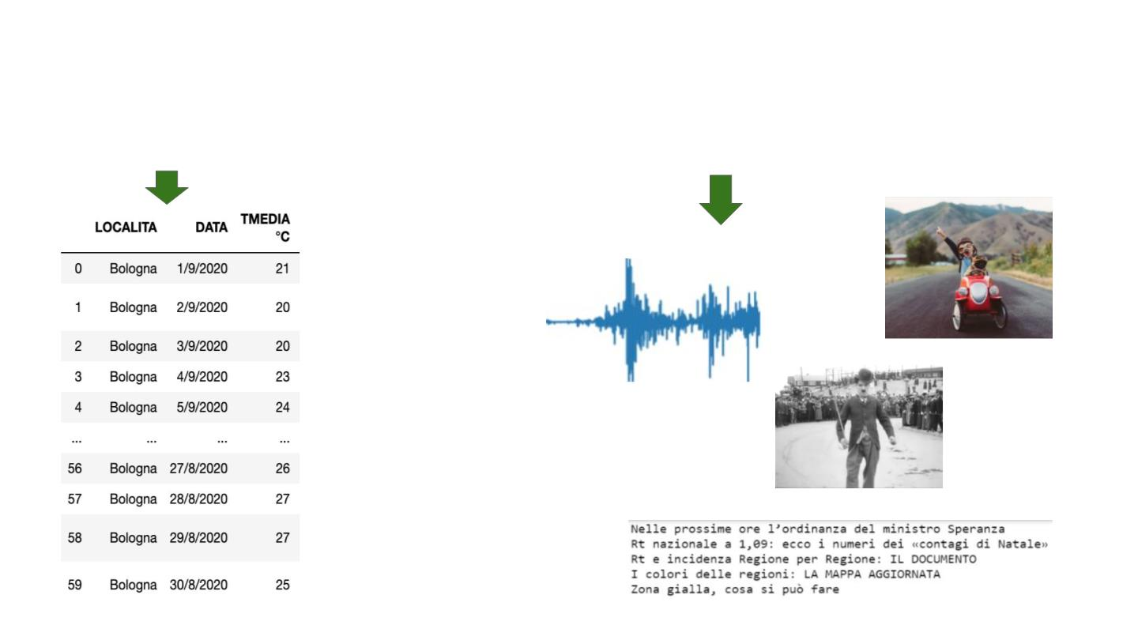
The difference between structured and unstructured data
Structured Data
Unstructured Data
Images
Audio
Video
Text

Slide 31

Data is never 100% OK - Clean and preprocess data.
1- No Headers in the data
2- Data has a different separator from the usual comma “,”
3- Presence of NaNs and outliers
4- Columns that contain different types of data (integers, floats, dates etc..)
5- There might be need to create new features
6- Normalize, standardize, tokenize (text data) etc..
7- Change or edit the datetime format if the data is a time series.
8- Impute missing data from the existing ones.
9- What else .. ?

Slide 32
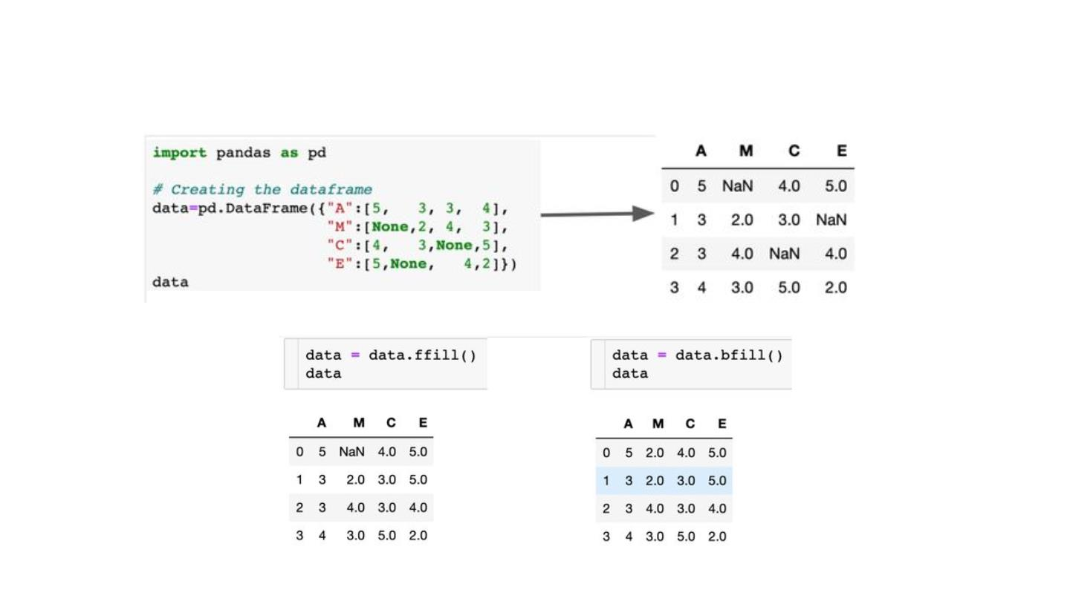
Data imputation in time series : Pandas ffill() and bfill() methods

Slide 33
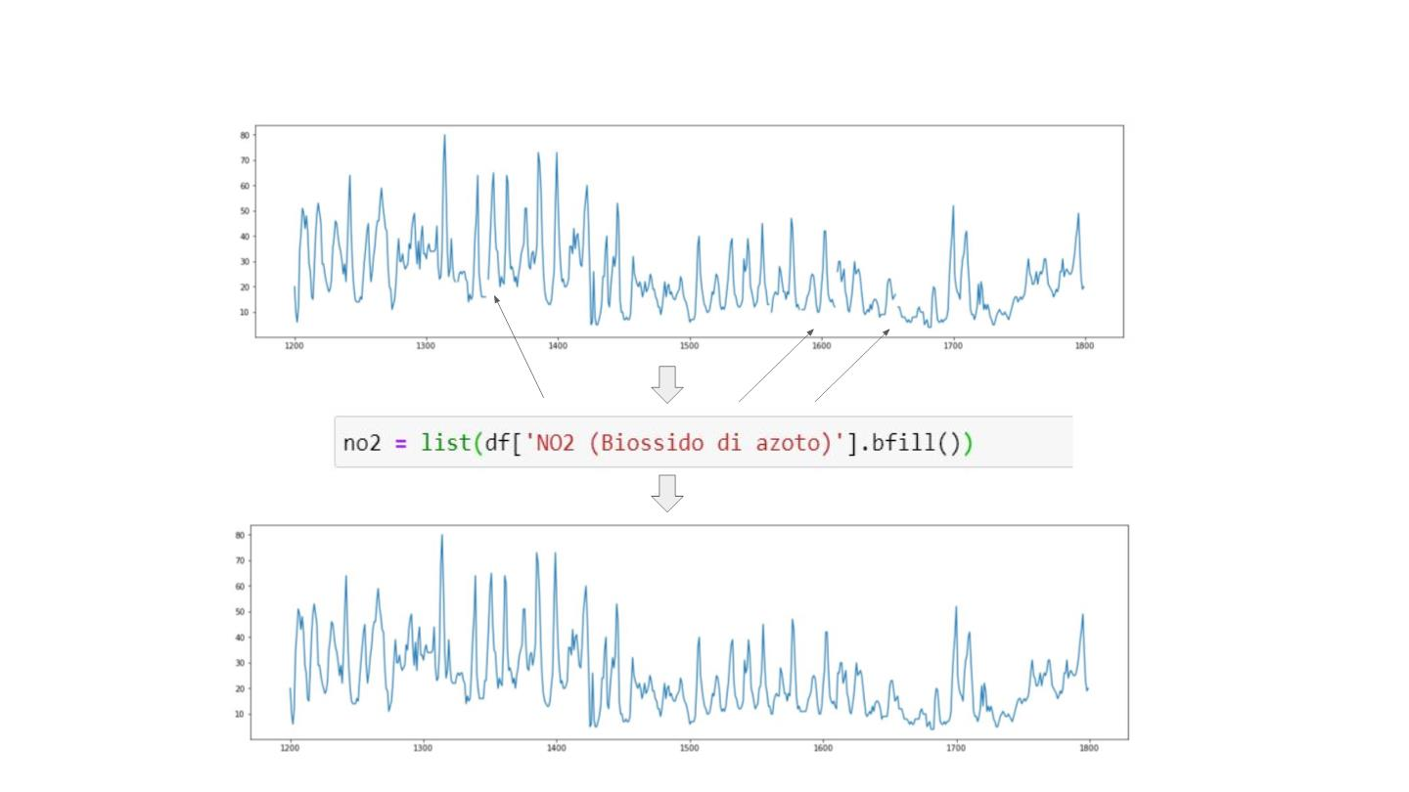
Clean and Impute missing data from the Air Quality data - ER Open data

Slide 34
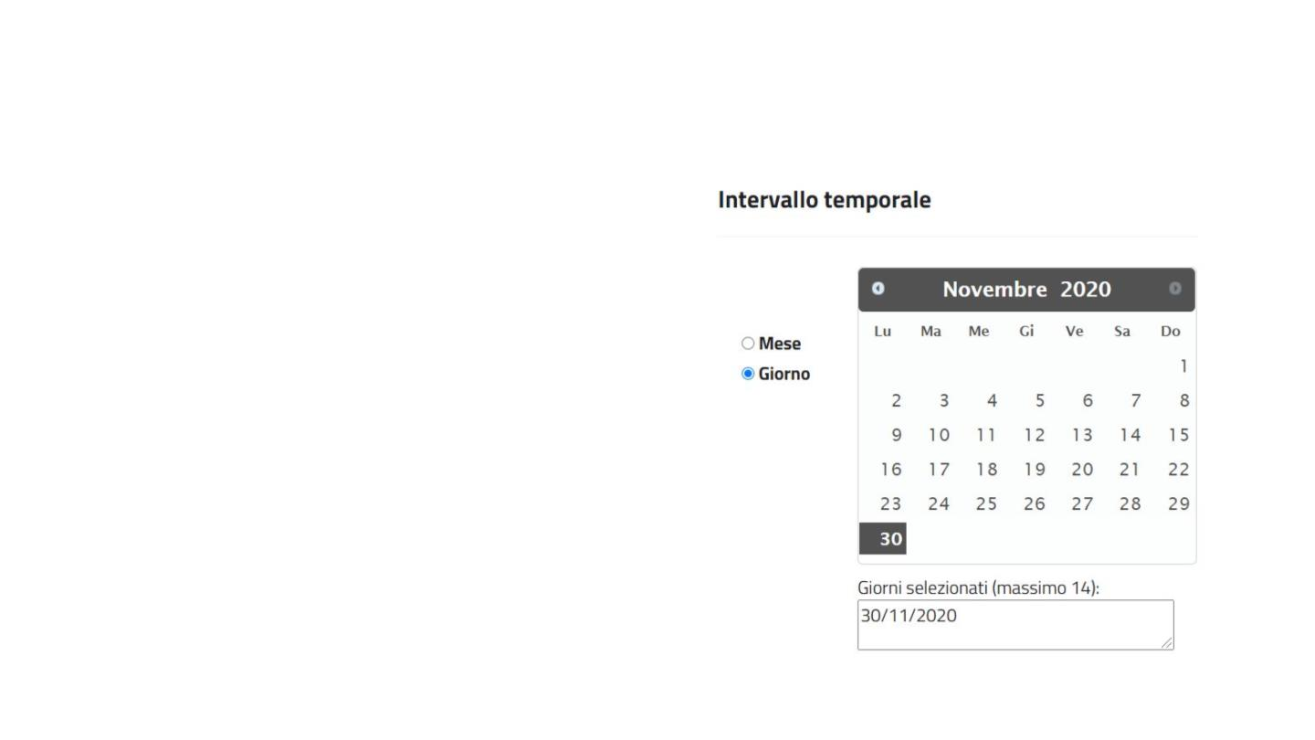
Aggregate multiple csv files of traffic data - ER MTS open
data
import csv
def merge_csv(csv_list, output_path):
# build a list with all fieldnames
fieldnames = list()
for file in csv_list:
with open(file, 'r') as input_csv:
fn = csv.DictReader(input_csv).fieldnames
fieldnames.extend(x for x in fn if x not in fieldnames)
# write the data to a output file based on field names
with open(output_path, 'w', newline='') as output_csv:
writer = csv.DictWriter(output_csv, fieldnames=fieldnames)
writer.writeheader()
for file in csv_list:
with open(file, 'r') as input_csv:
reader = csv.DictReader(input_csv)
for row in reader:
writer.writerow(row)

Slide 35
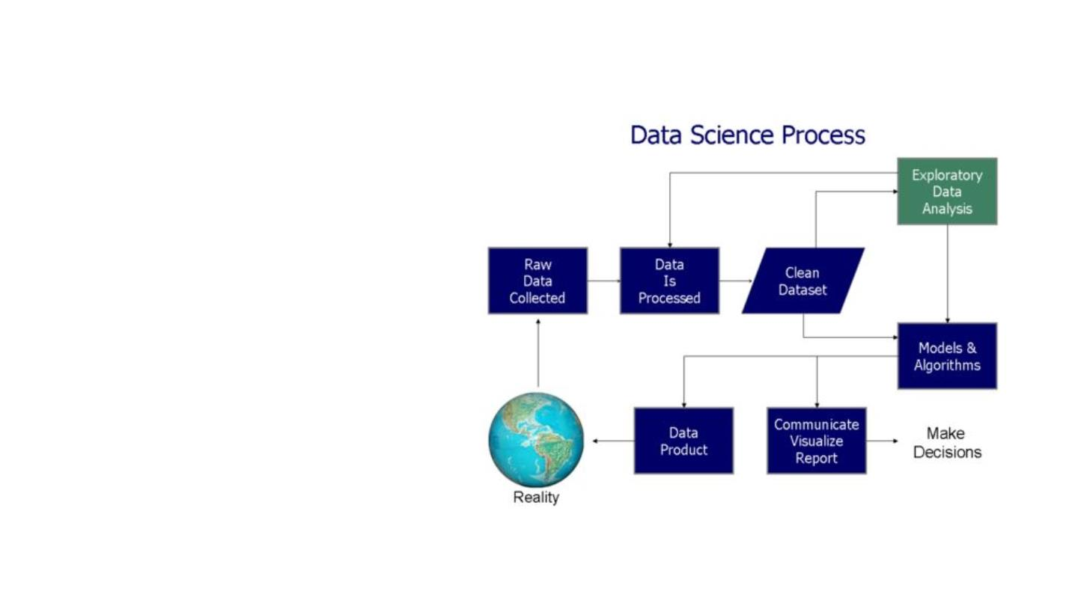
Exploratory Data Analysis - Aggregation and Analysis
1- EDA aims to analyzing data
sets so to summarize their main
characteristics, often with visual
methods.
2- Can a statistical model can be
used or not ?
3- EDA is for seeing what the
data can tell us beyond the formal
modeling or hypothesis testing
task.

Slide 36
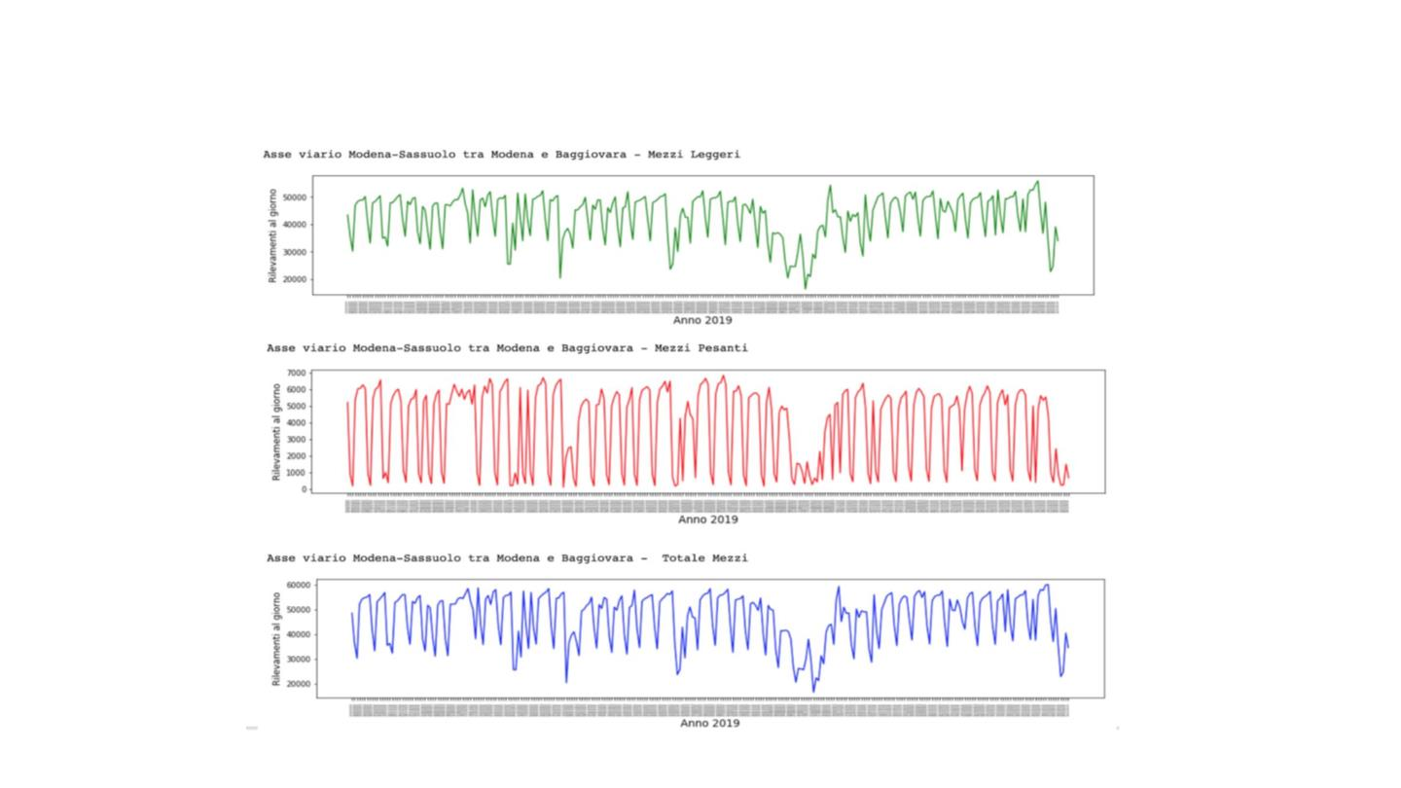
EDA - Aggregate and visualize data - air quality & traffic

Slide 37
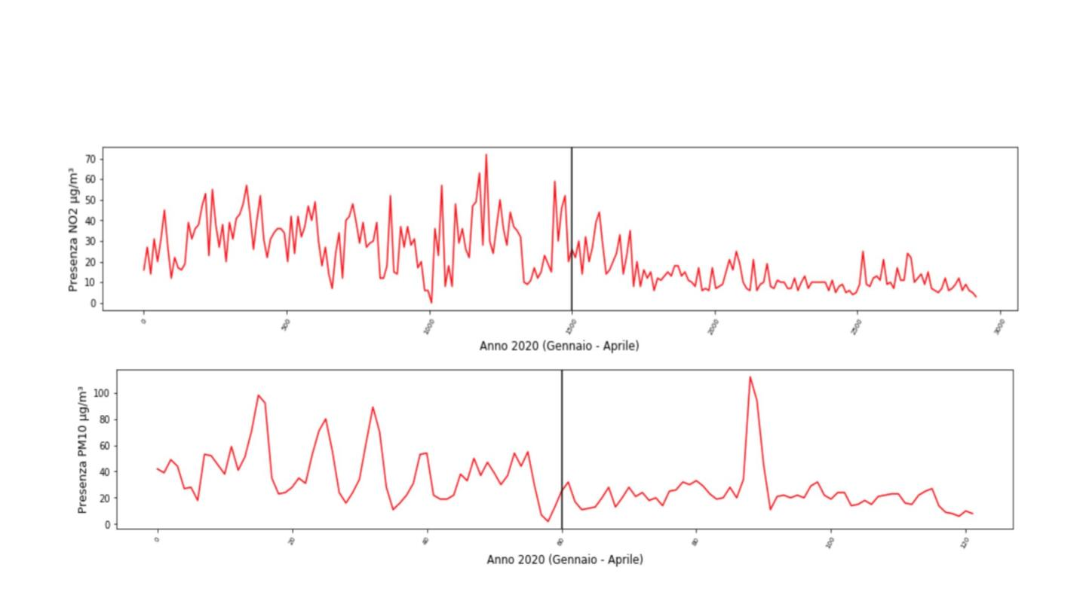
EDA - Aggregate and visualize data - air quality & traffic

Slide 38
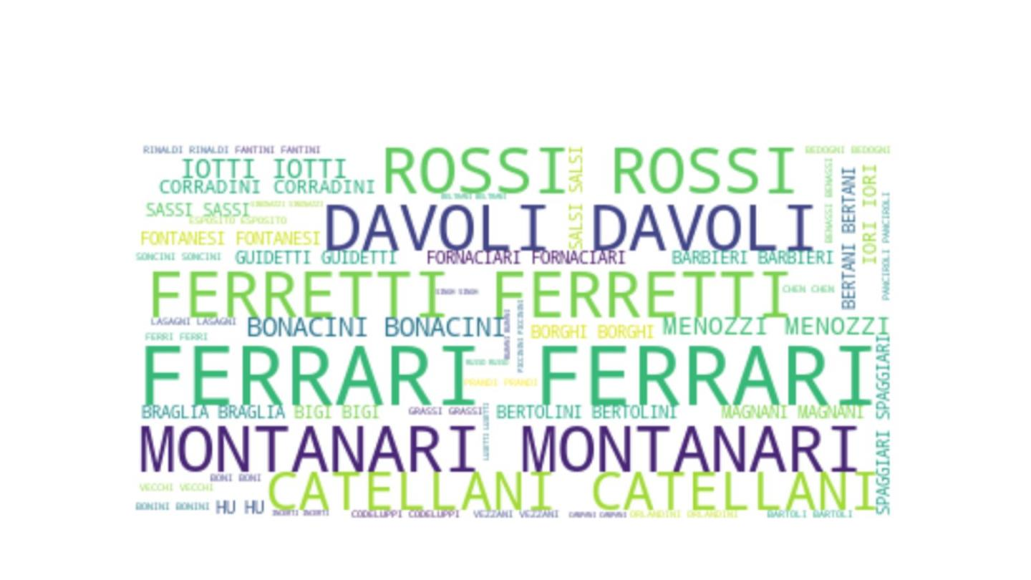
EDA - Aggregate and visualize Population data - Surnames
dataset

Slide 39
Hands-or Collecting and Visualizing Data: Ex 2
Collect and visualize data using the Emilia Romagna Open Data
Platform.
Collect and visualize data from other sources that should be different
from those seen during the lesson.

Slide 40
Recommendation Systems - Collaborative Filtering

Slide 41
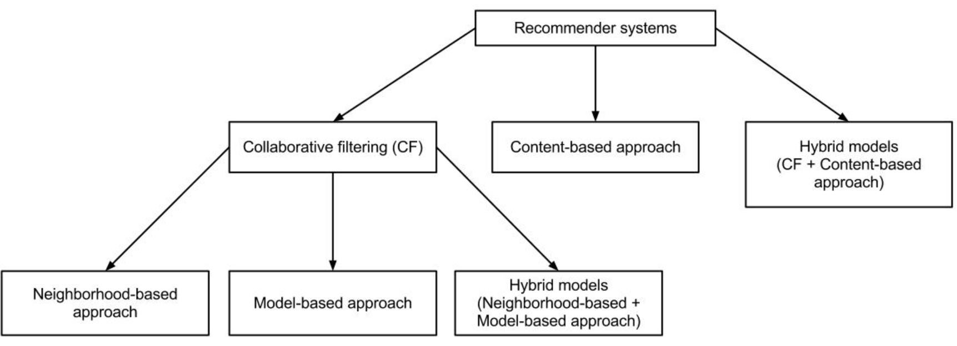
Recommendation Systems - Collaborative filtering

Slide 42
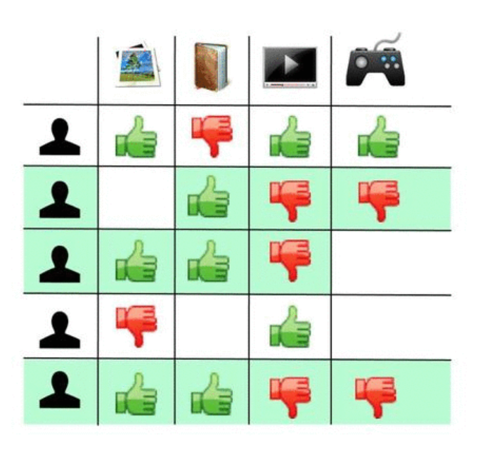
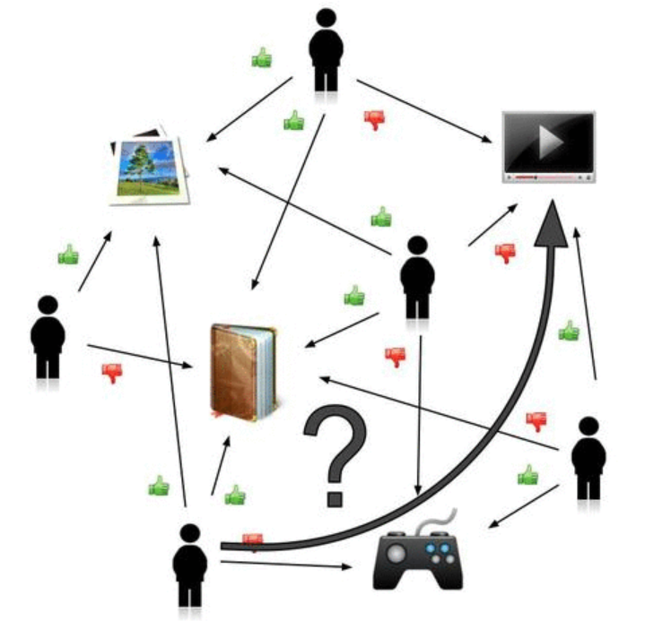
Collaborative filtering - A matter of choice

Slide 43
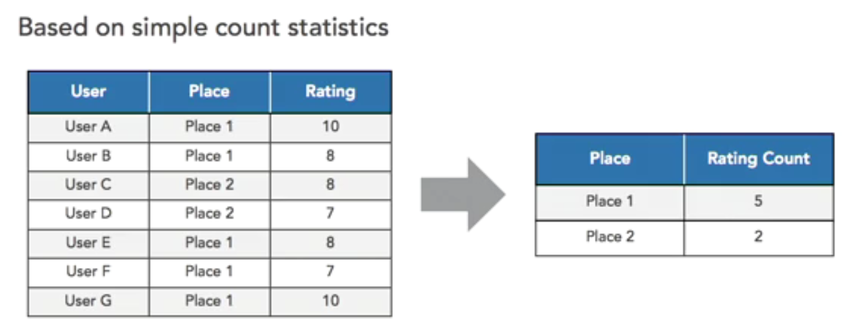
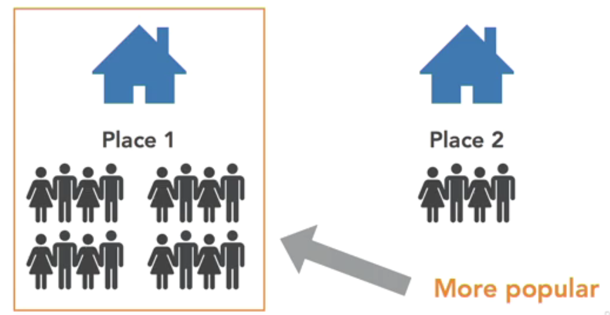
Popularity-based Recommendation Systems

Slide 44
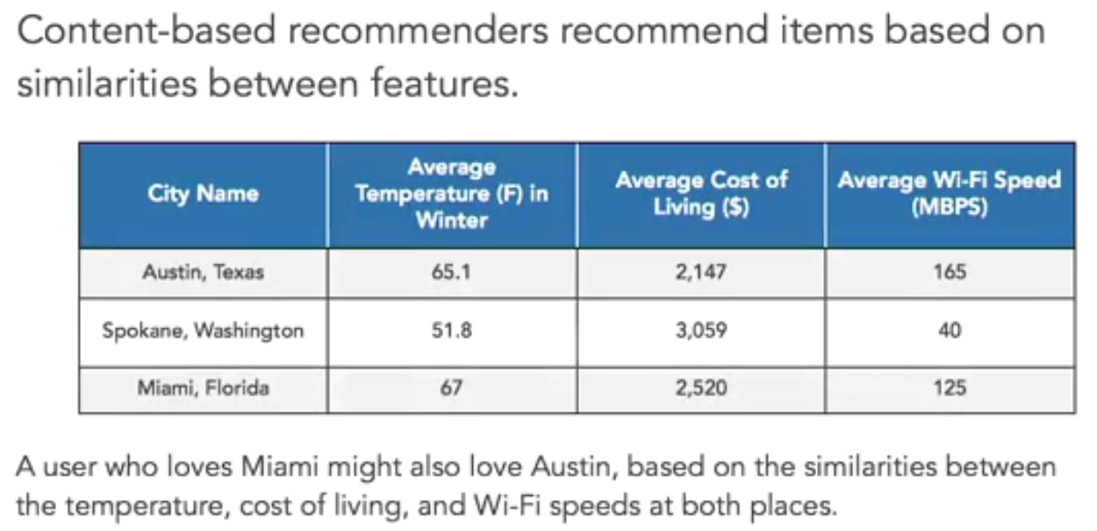
Similarity-based Recommendation Systems

Slide 45
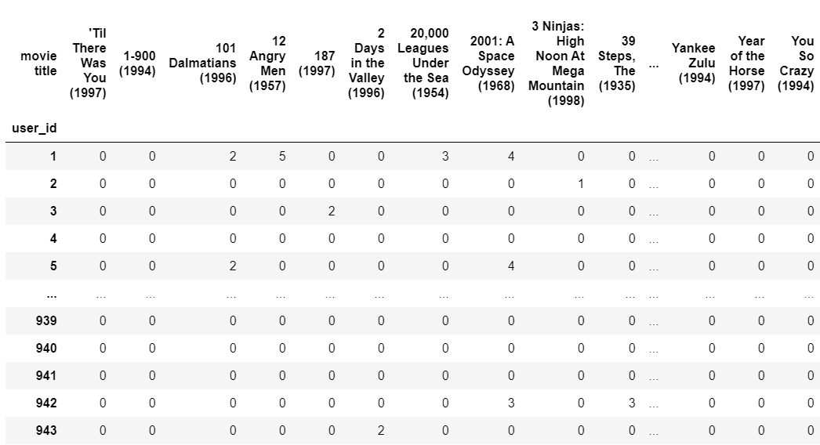
A Recommendation System in Python
MovieLens dataset https://grouplens.org/datasets/movielens/

Slide 46
The Singular Value Decomposition Method
A linear algebra method that can decompose a utility matrix into three matrices.
Model-based recommender - use these three compressed matrices to make recommendations without having to refer back to the complete dataset
Latent variable - inferred, non observable variables that are present within and affect the behavior of the dataset

Slide 47
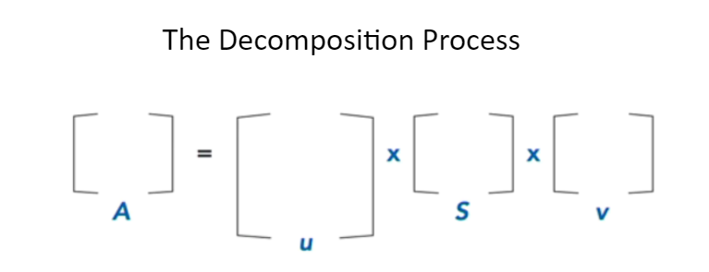
A = Utility Matrix
u = Left Orthogonal matrix- holds important info about users
v = Right Orthogonal Matrix - holds important info about items
S = Diagonal Matrix - holds the info about the decomposition process
A = u * S * v

Slide 48
Evaluating Recommendation Systems
Precision: How relevant were the recommendations that my system provides?
Recall: How complete was the set of recommendations that my sistem gave to the customer?
P = Nr of items that the customer liked from the recommendation / Nr of items recommended
R = Nr of items that the customer liked from the recommendation / Nr of items he likes

Slide 49
Association Rules - Market Basket Analysis

Slide 50
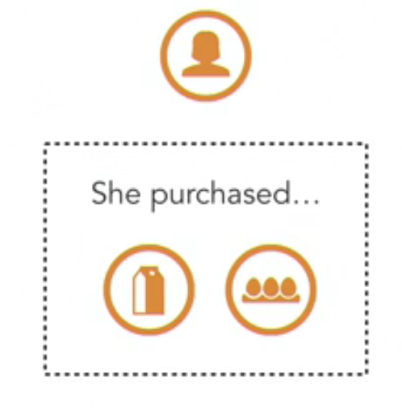
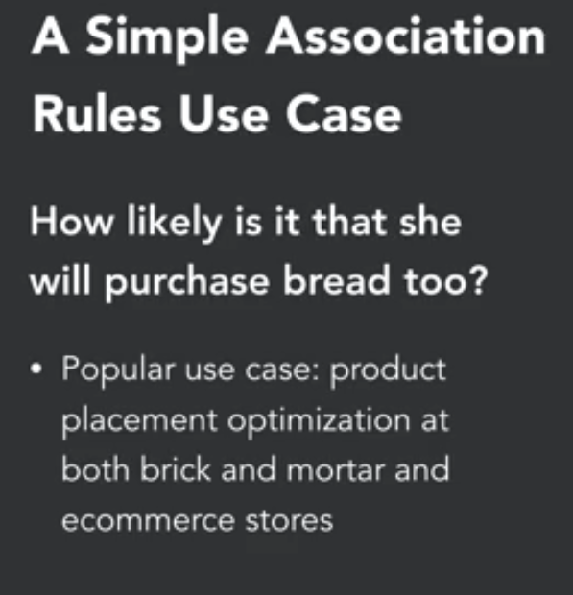
Association Rules

Slide 51
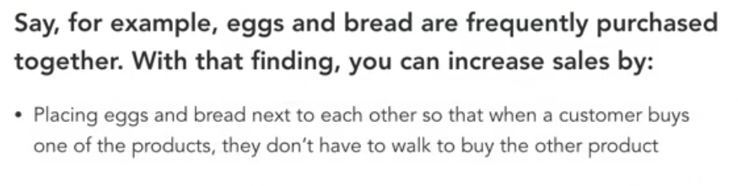
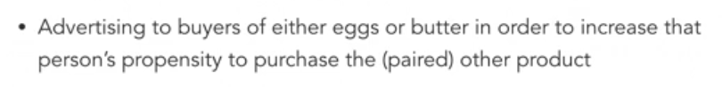
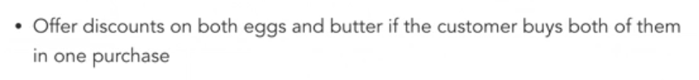
Association Rules

Slide 52
Association Rules - Semantics and Advantages
Association Rule:
If item eggs are purchased, then the possibility of buying bread is… ?
It can also be represented as :
{eggs} {bread}
Advantages.
Fast
Works with small datasets
No feature engineering

Slide 53
Association Rules
Scenario: 5000 total transactions in a supermarket
A = Bread purchases = 500 transactions
C = Eggs purchases = 350 transactions
(A → C) Both Bread and Eggs purchased

Slide 54
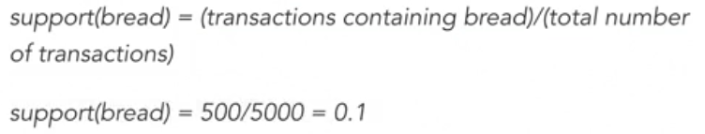
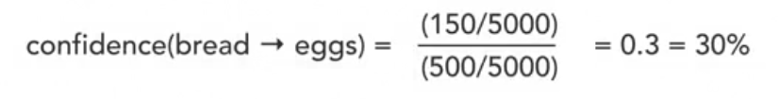
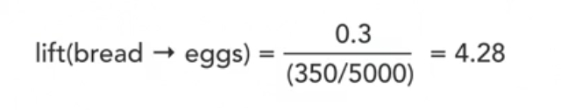
Association Rules - Measures

Slide 55
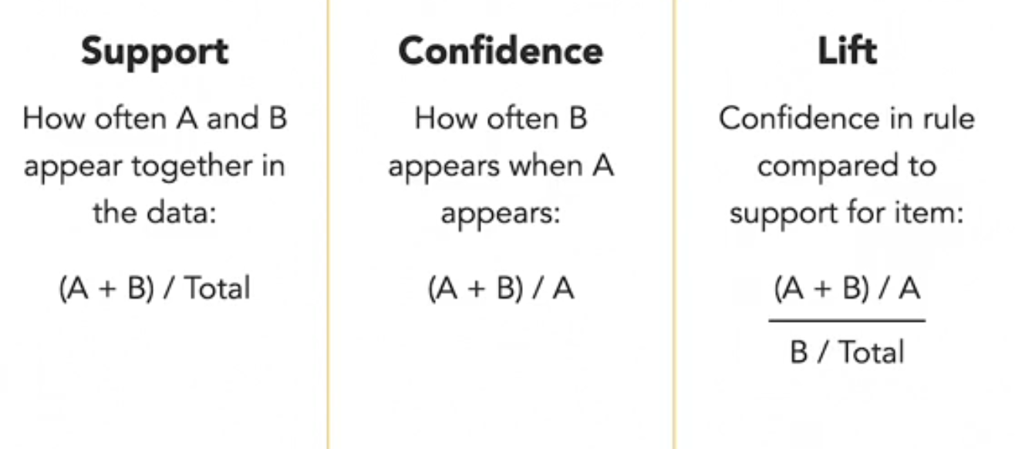
Association Rules - Support, Confidence, Lift

Slide 56
About the Importance of Lift in Understanding the Rules
Lift score > 1 : A is highly associated with C. If A is purchased then it is likely that C is also purchased
Lift score < 1: If A is purchased, it is unlikely that C will be purchased
Lift score = 1 : Indicates that there is no association between the two items A and C

Slide 57
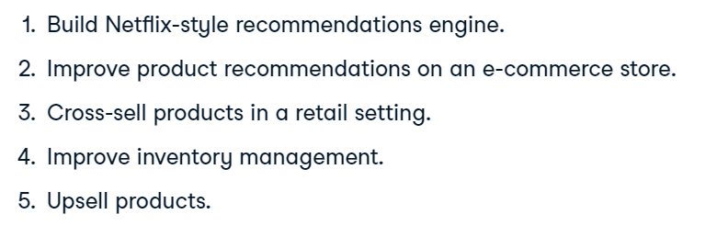
Association Rules - Some (not so) famous use cases.

Slide 58
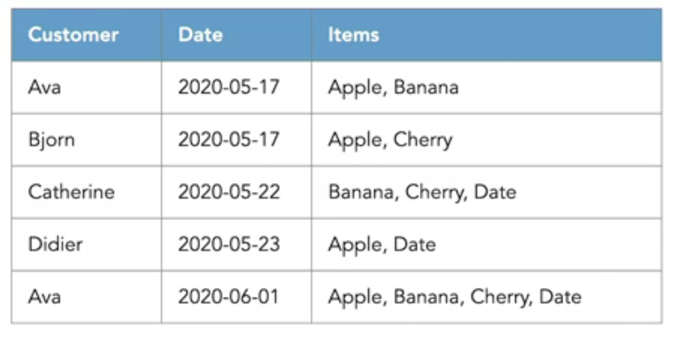
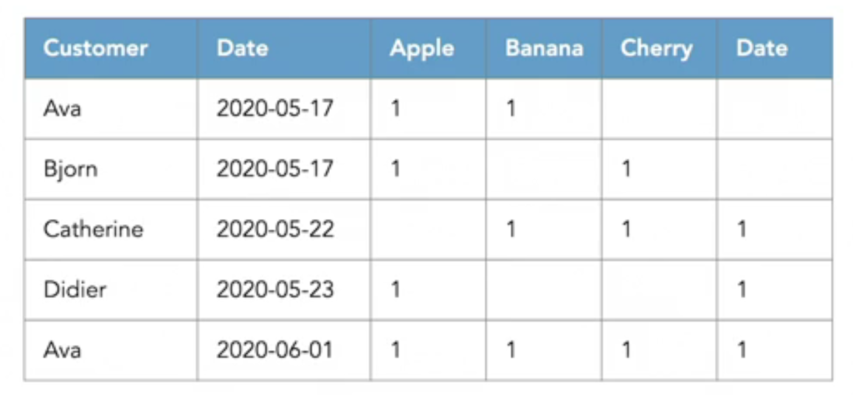
Association Rules - Useful for studying buying patterns.

Slide 59
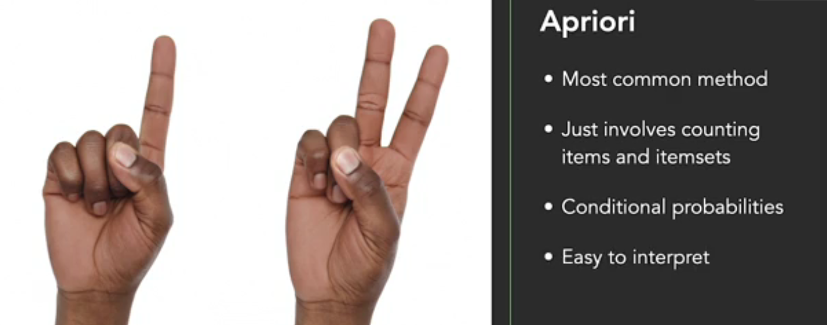
Association Rules - The Apriori Method

Slide 60
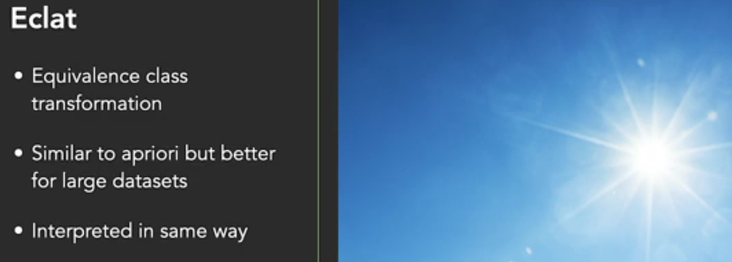
Association Rules - Eclat Method

Slide 61
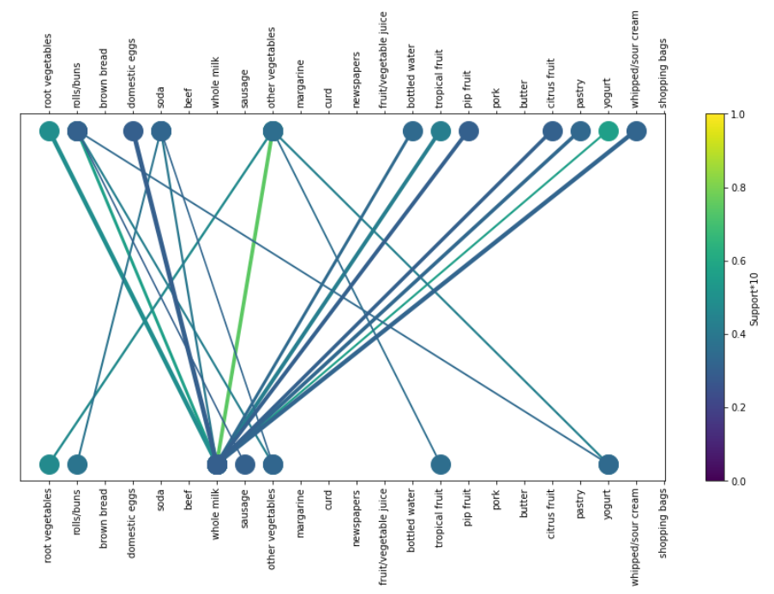
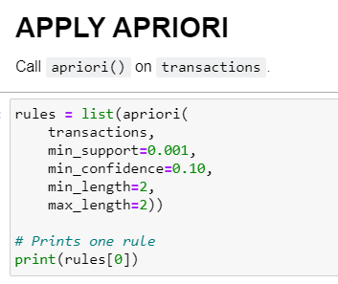
Association Rules: Apriori

Slide 62

Association Rules: Eclat

Slide 63

Association Rules : FP-Growth

Slide 64
Unsupervised Machine Learning - Clustering

Slide 65

Have you ever been into a library? Not very useful if you don’t know where to search for a book!

Slide 66

Clustering Algorithms - Criteria

Slide 67

Clustering Algorithms - Data Dimensions

Slide 68

Clustering Algorithms - the k-Means algorithm

Slide 69

Clustering Algorithms - Hierarchical Clustering

Slide 70

Clustering Algorithms - DBSCAN

Slide 71


Clustering Algorithms: k-Means

Slide 72

Clustering Algorithms: Hierarchical clustering.

Slide 73


Clustering Algorithms: DBSCAN
The parameter eps (Epsilon neighborhood radius) stands for the optimal number of clusters.

Slide 74
Predictive Analytics - Linear Models

Slide 75
Predictive Analytics - Linear Models
Data science is about building models to describe, predict, and extract patterns.
The most fundamental of these patterns is a linear relationship between two
variables X and y where y = f(X).
Some techniques for quantifying, and modeling linear relationships in data are :
● least-squares method,
● linear regression (on univariate and multivariate data)
● estimation or estimators
● bootstrap resampling.

Slide 76
Linear Regression on Univariate and Multivariate Data
● Linear Regression is a statistical (machine learning) method that can be
used to quantify and make decisions based on a numerical relationship
between variables.
○ Simple Linear Regression : one predictor and one predictant.
○ Multiple Linear Regression : multiple predictors and one predictant.
● Some examples of such relationships :
○ Relationship between the number of the rooms in a house and its price.
○ Relationship between salary and years of experience.
○ Relationship between money spent on ads and revenue.
○ Relationship between weather temperatures and energy consumption.

Slide 77

Explaining Linear Regression Intuitively

Slide 78

Assumptions about data when using Linear Regression
Models

Slide 79

Implementation of Linear Regression Models: Python Packages
statsmodels:
○ optimized for insights
scikit-learn:
○ optimized for predictions.

Slide 80

When it makes sense to perform a regression analysis?

Slide 81

Simple Linear Regression : Years Experience vs Salary

Slide 82

Multiple Linear Regression - Ads and Revenue Pairplot

Slide 83


Slide 84


Slide 85

Multiple Linear Regression - Ads and Revenue: Regression Line

Slide 86

Multiple Linear Regression - Startup Costs vs Profit

Slide 87
Model the relationship benn variables and apply Linear
Regression: Ex 3
Think about a simple use cases where the relationship between the
two variables can be modelled as a linear model. Can you use Linear
Regression for making predictions ?

Slide 88
Predictive Analytics - Classification Models

Slide 89

Preface on Classification Algorithms
The difference between clustering and classification

Slide 90

K-Nearest Neighbors Classification Algorithm

Slide 91

Logistic Regression for Classification Problems

Slide 92

The C parameter for Logistic Regression

Slide 93
Use sklearn to solve Classification Problems : Ex 5
Use the mtcars dataset to classify the data based on automatic or manual transmission.
Train a KNN ( K-nearest neighbor) algorithm to classify the data
Test the performance of KNN and measure the classification accuracy
Repeat the same steps with Logistic Regression Algorithm

Slide 94

Image Processing and Classification

Slide 95



Image processing with OpenCV: working with pixels and arrays on more that two dimensions
….….

Slide 96

Image Processing: images and their dimensions
A black & white picture has only one layer (only two dimensions) as of next slide!

Slide 97


Images are made of a large number of pixels
A black & white picture of number zero
Working with black & white pictures is much easier and this is the reason why different applications perform a transformation into B&W first.

Slide 98

Working with videos in OpenCV - Video processing
Read and display videos in OpenCV
Access videocamera of your PC-Mac
Access and record a video with the camera of your PC-Mac
Create a video from a set of images.

Slide 99

Image classification and object detection

Slide 100

Google’s Teachable Machine
https://teachablemachine.withgoogle.com/
Traning the classifier

Slide 101


Slide 102
Use Teachable Machine to solve a real world problem : EX 5
Find pictures online (or simply use those in your smartphone) and
load them into Teachable Machine.
Build a classifier that solves a real world problem . What is the result?

Slide 103
Evaluation Metrics for Machine Learning Results
The key question. How well our model has performed? The evaluation metrics can
answer the question.
Two types of problems in machine learning.
1 - Regression Problems like for example Time Series Forecasting.
Quantify the error as already explained for Time Series Forecasting by using the
MAE or MAPE
2- Classification Problems like Spam Filters.
Quantify the performance of the classification algorithm by using accuracy,
precision, recall and F-score.

Slide 104

The statistical background behind ML Metrics
Type I error: occurs when you incorrectly reject a true null hypothesis.
Type II error: occurs when you fail to reject a false null hypothesis
Null Hypothesis : The woman is visibly pregnant, the man is probably not!
The Medical metaphore to understand better and easily remember Type I and Type II errors.

Slide 105

Classification Metrics: Classification Accuracy
Accuracy is one metric for evaluating
classification models. Informally,
accuracy is the fraction of
predictions our model got right.
For binary classiﬁcation,
accuracy can also be calculated
in terms of false/true positives and negatives
Where TP = True Positives, TN = True Negatives, FP = False Positives, and FN = False Negatives.

Slide 106

The Problem With The Accuracy!
The accuracy of a classification model that classiﬁed 100 tumors as malignant
(the positive class) or benign (the negative class)
But how good is this
result in reality ?

Slide 107

Classification Metrics. Not Only Accuracy: Precision, Recall
In pattern recognition, information
retrieval and classification (machine
learning), precision (also called
positive predictive value) is the
fraction of relevant instances among
the retrieved instances, while recall
(also known as sensitivity) is the
fraction of relevant instances that were
retrieved. Both precision and recall are
therefore based on relevance.

Slide 108

How to Compute the Precision : Some Examples
We want to recognize dogs in photographs.
CV system identifies 8 dogs in a picture containing
10 cats and 12 dogs.
Of the 8 it identifies as dogs, 5 actually are dogs (true
positives), while the other 3 are cats (false positives).
7 dogs were missed (false negatives), and 7 cats
were correctly excluded (true negatives).
The precision is 5/8 (true positives / all positives).

Slide 109

How To Compute The Recall: Some Examples
We want to recognize dogs in photographs.
CV system identifies 8 dogs in a picture containing
10 cats and 12 dogs.
Of the 8 it identifies as dogs, 5 actually are dogs
(true positives), while the other 3 are cats (false
positives).
7 dogs were missed (false negatives), and 7 cats
were correctly excluded (true negatives).
The recall is 5/12 (true positives / relevant elements)

Slide 110

More Classification Metrics: F or F1 Score
In statistical analysis of binary classification, the F-score or F-measure is a measure of a
test's accuracy. It is calculated from the precision and recall of the test.

Slide 111

Classification Metrics: Confusion Matrix
The Confusion Matrix show the
number of correctly classified
items and the number of
misclassified items for each class.

Slide 112

K-Fold Cross Validation
Question: What if we created a bunch of train/test splits, calculated the testing accuracy for each, and averaged the results together?
Answer: That's the essence of cross-validation!
Steps for K-fold cross-validation
Split the dataset into K equal partitions (or "folds").
Use fold 1 as the testing set and the union of the other folds as the training set.
Calculate testing accuracy.
Repeat steps 2 and 3 K times, using a different fold as the testing set each time.
Use the average testing accuracy as the estimate of out-of-sample accuracy.

Slide 113

Optimize Classification Results for Precision or Recall
Most of the time, there is a trade-off to be reached between the precision and the recall.
However, depending on the specific applications, we need the results of a classification algorithm to be optimized for:
1- Precision
2- Recall

Slide 114



Finding the Best Parameters for ML Models with GridSearchCV

Slide 115
Hands on performance metrics : Ex6
Measure the performance of the classifier we build with Wikipedia
articles by showing, accuracy, precision, recall, and the confusion
matrix.
Finally compute F-score as well.

Slide 116

Running Jupyter Notebooks on Google’s Cloud

Slide 117

Mount the Drive and Load Data

Slide 118
Deployment and Machine Learning Life Cycle

Slide 119

Machine Learning Life Cycle - MLLC
1- Gather data
2- Data Preparation
3- Data Wrangling
4- Analyse Data
5- Train Models
6- Test Models
7- Deployment

Slide 120
Deployment of ML models - Different ways to deploy.
deploying on a server (for example with a REST API in Flask)
deploying in a container (such as Docker)
serverless deployment
model streaming — instead of REST APIs, all of the models and application code are registered on a stream processing engine like Apache Spark, Apache Storm, and Apache Flink.

Slide 121

Deployment of ML models with REST API in Flask

Slide 122

Introduction to Flask - How to use it for Model Deployment.

Slide 123

Streamlit : Serverless application for machine learning deployment

Slide 124


Streamlit : Serverless application for machine learning deployment

Slide 125



Using Streamlit with Yahoo Finance Data

Slide 127
Deploy a Linear Regression MLM by using Flask
Use Case to be shown during the practical part of the lessons.

Slide 128
Deploy a Classification MLM using Flask REST API
Use Case to be shown during the practical part of the lessons.

Slide 129
Deploy a Classification MLM using Streamlit Serverless API
Use Case to be shown during the practical part of the lessons.

Slide 130
Build an interface in HTML for the deployment process.
Use Flask with HTML to make and interface
where the use can insert the input to be classified.

Slide 131

Software Version Control with Git and Github

Slide 132

Git and Github

Slide 133

Branching and Merging with Git and Github

Slide 134

Git Essential Commands

Slide 136
Apache Spark

Slide 137

Why use Spark?
Spark is 100 x faster than Hadoop for both streaming and batch data
Easy to use in Java, Scala, Python, R, and SQL.
Combines SQL, streaming, and complex analytics

Slide 138

Spark’s Architecture

Slide 139

Spark Components

